Slide 1

Online free Store System

Slide 2

The idea is called a "free store" because it offers a unique opportunity for citizens to responsibly get rid of items they no longer use by getting them into the possession of someone that will need them, free of charge, in a way that often builds community. If you have any spare cash, it's also an excellent opportunity to help somebody else.

Slide 3

DOES THAT MAKE SENSE? FREE STORES ARE POPULAR UP ALL OVER THE GLOBE. FREE STORES CAN HAVE VARIOUS TYPES, RANGING FROM A BOX ON A STREET CORNER WHERE CUSTOMERS CAN DROP PRODUCTS THEY NO LONGER WANT, A COMMUNITY PANTRY, TO AN OPEN-AIR MARKET TO AN ENTIRE BRICK AND SHOPS.

Slide 4
Muryo

Slide 5
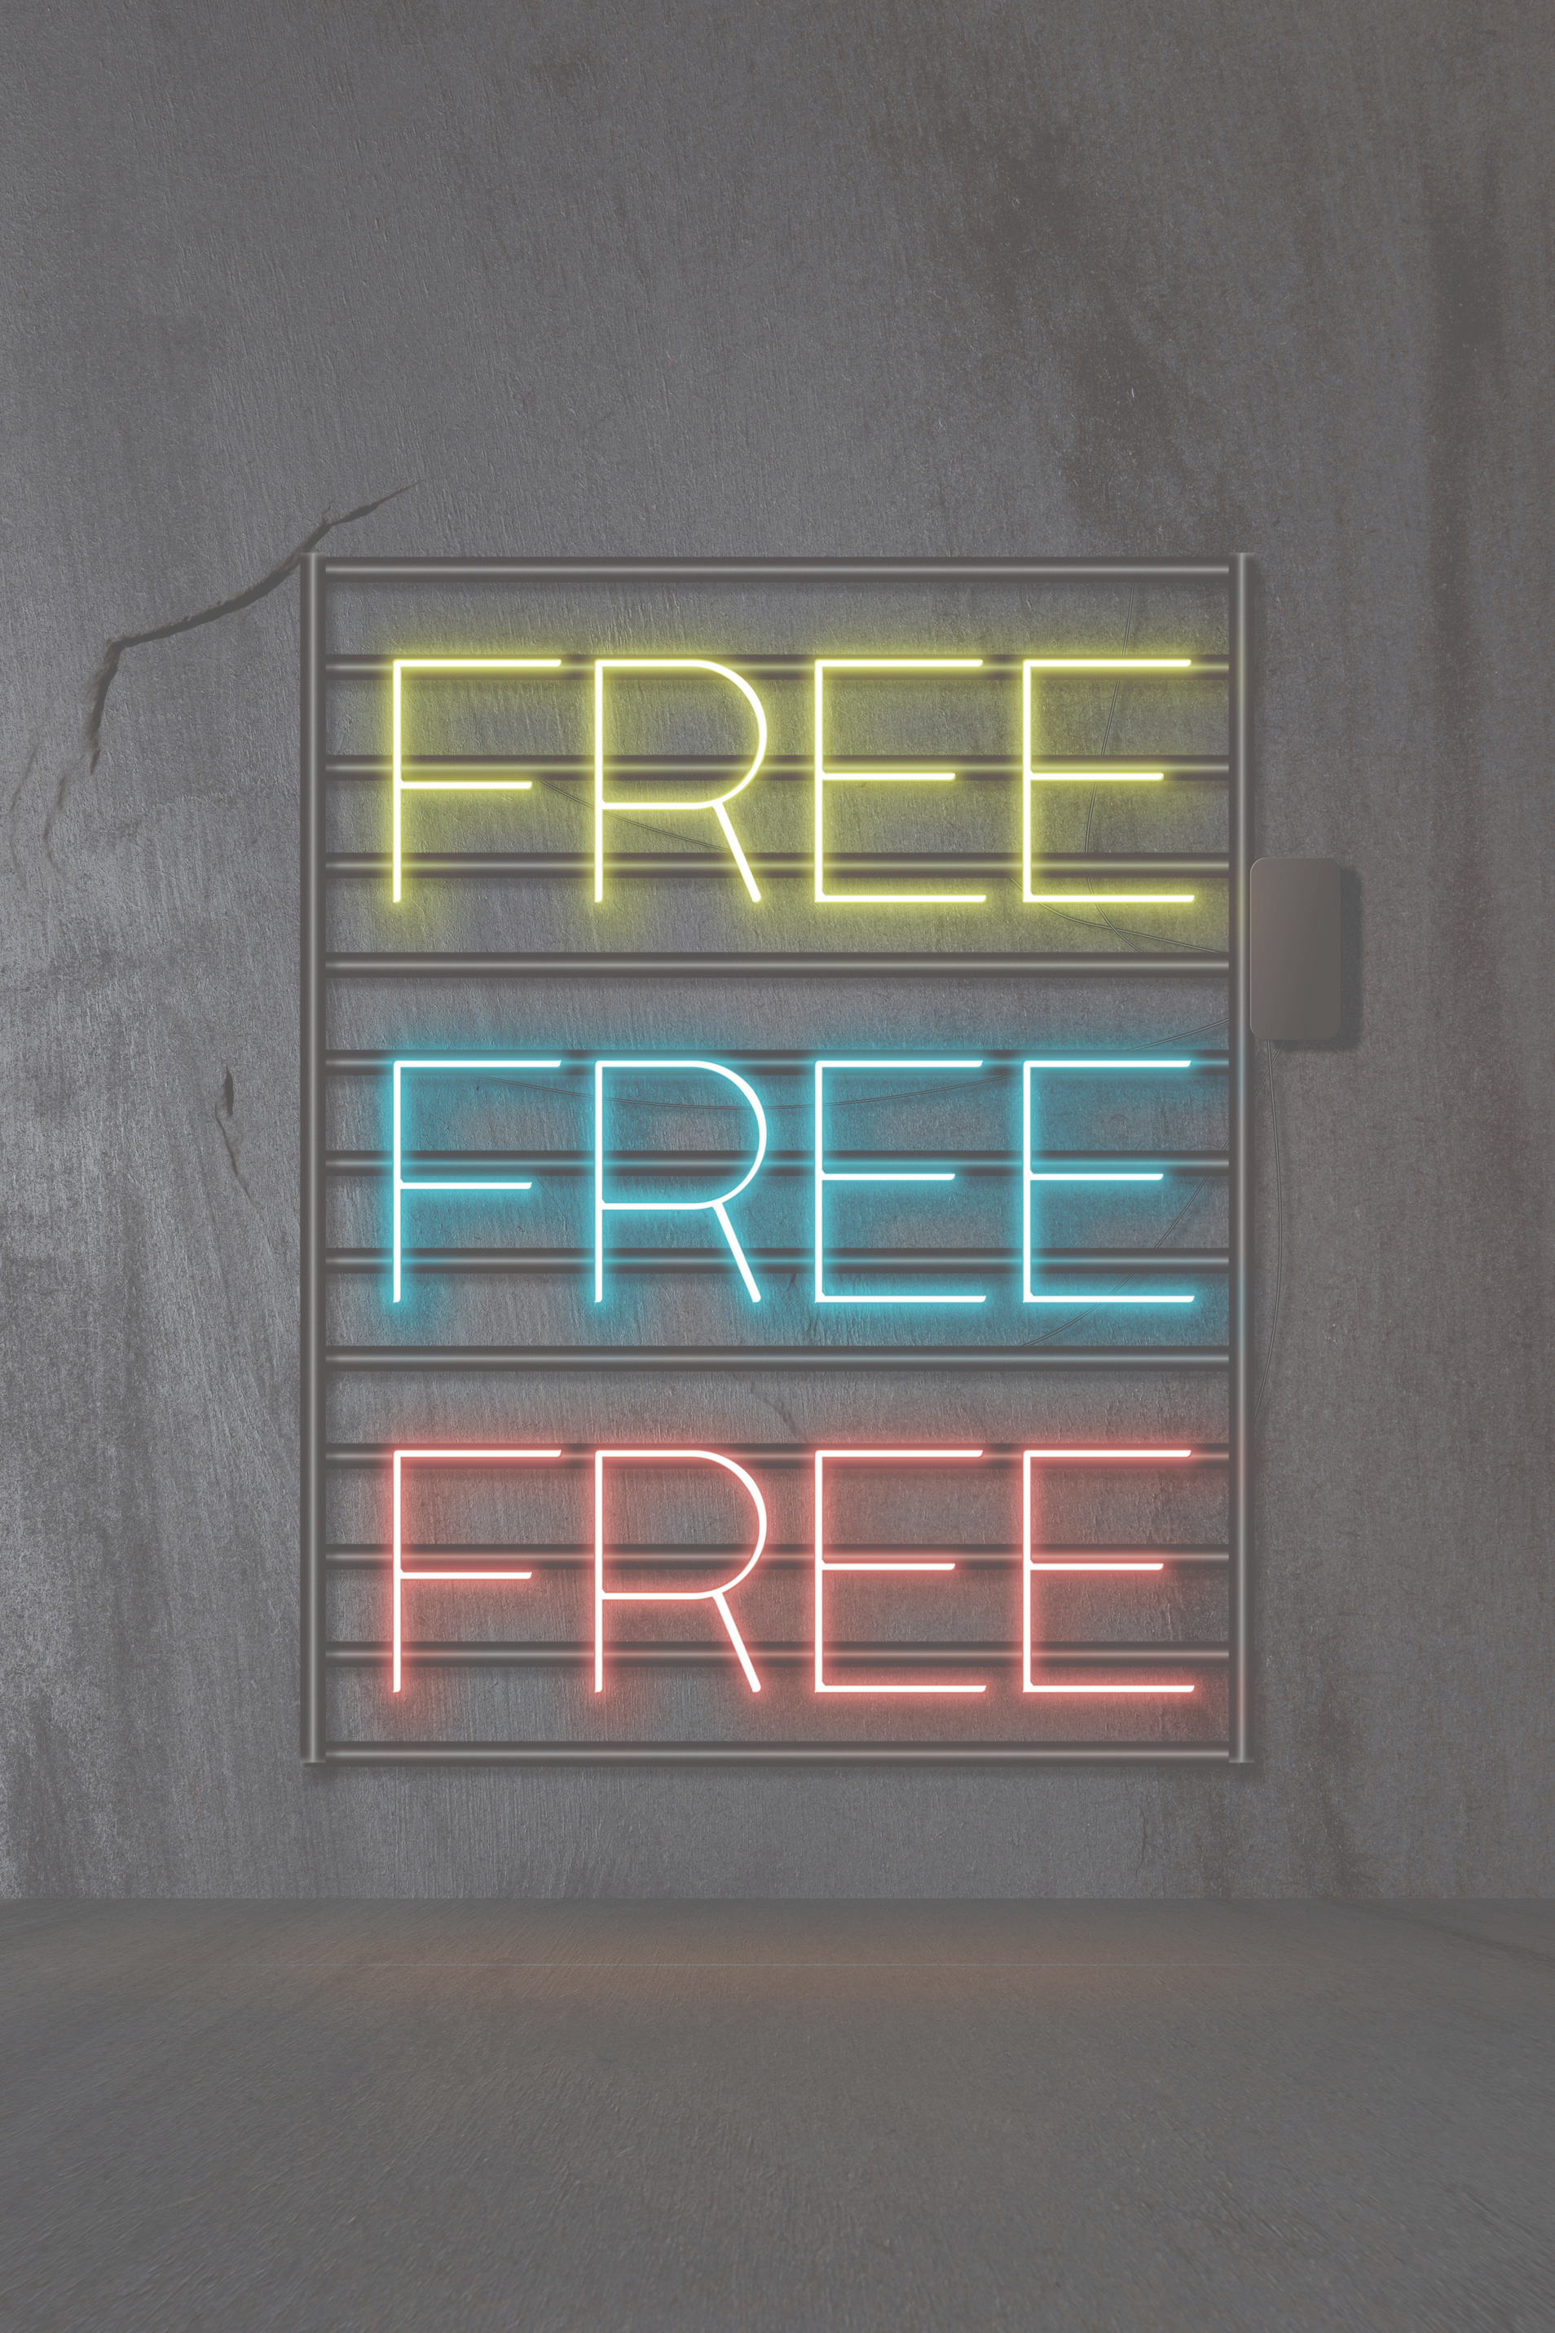
"Muryo" is the term used in japanese meaning "free".
Muryo

Slide 6


THE MCGI FREE SHOP AND THE OLIO APP IN LONDON SERVED AS MOTIVATION FOR THIS PROGRAM. IT'S ALSO A WAY TO ADD JOY TO THOSE WHO ARE IN NEED, AS WELL AS THOSE WHO PARTICIPATE. DONATING OBJECTS MAY HAVE A SIGNIFICANT BENEFICIAL IMPACT ON FAMILIES, SOCIETIES, AND CULTURE AS A WHOLE.

Slide 7
The Language used is C# with a combination of MySQL database. The program uses a visual studio form in order to have a design.
The purpose of the program is to allow the users to buy products from the posted products of the vendor in Database.

